Slide 1
C2C Admissions Professionals Training
101 Beginner Session
Admissions, Operations & Registrar Professionals

Slide 2
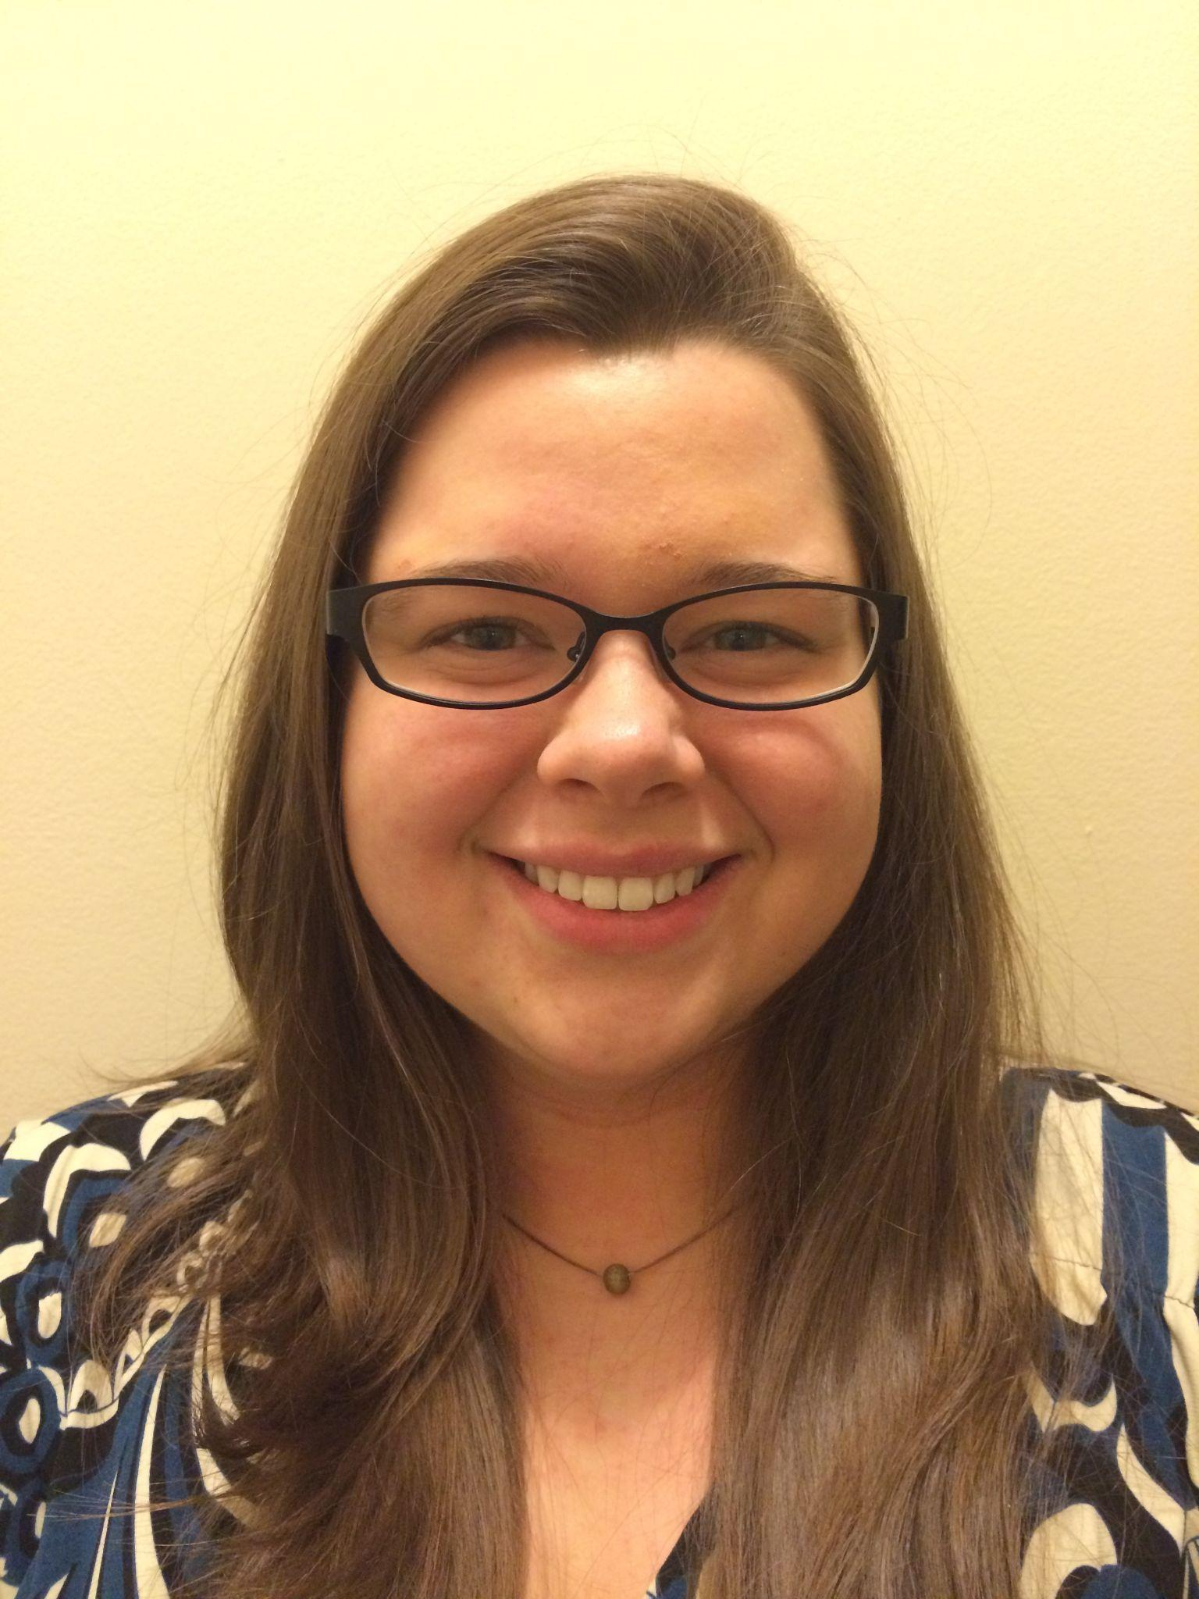
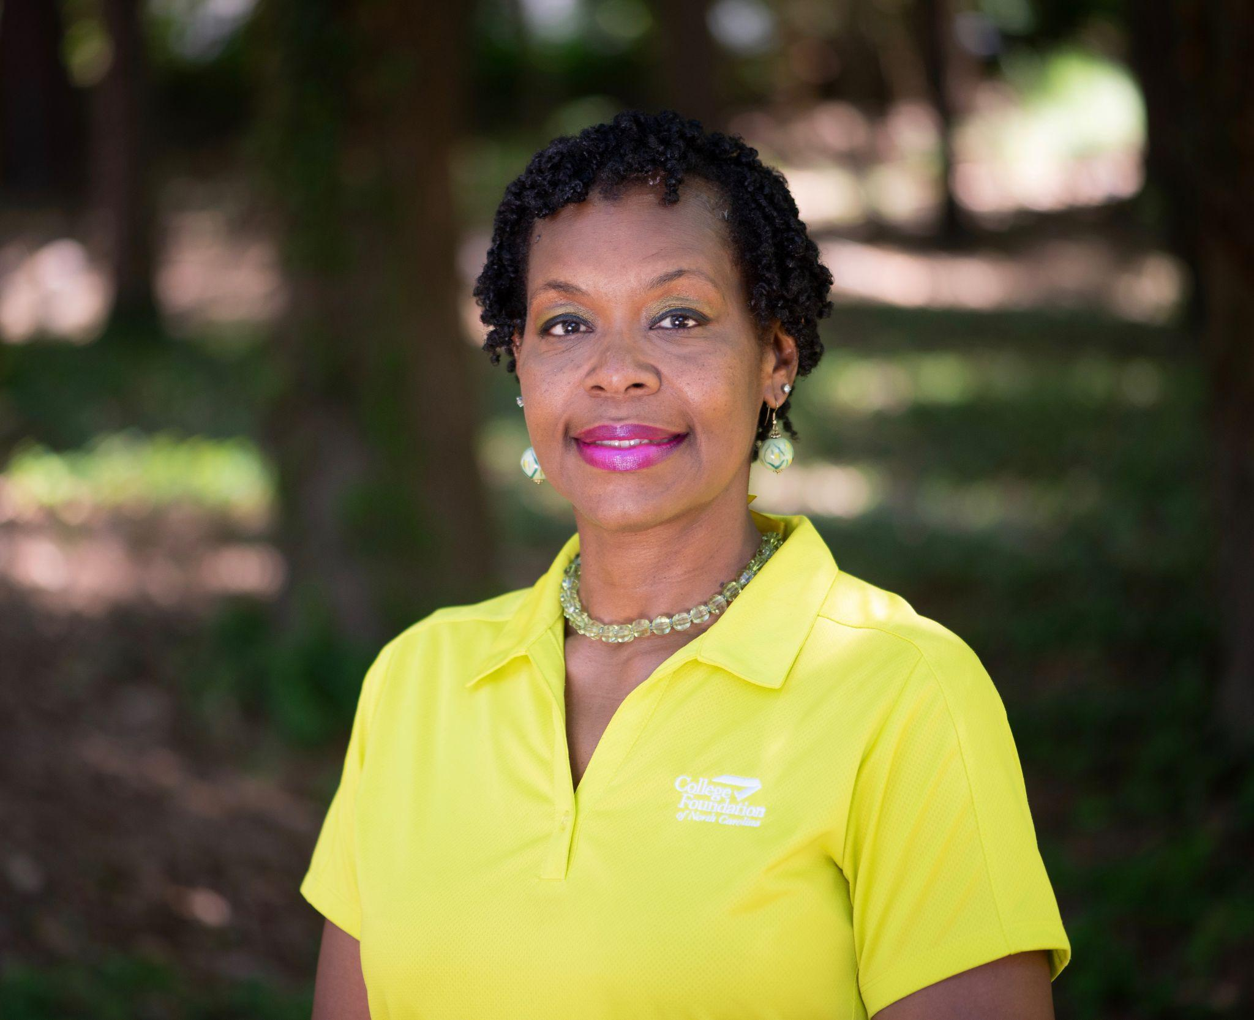
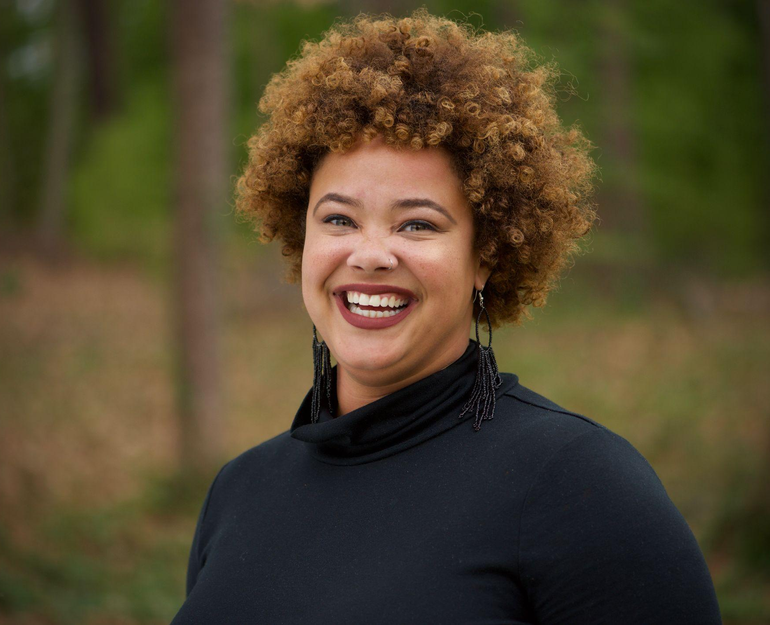
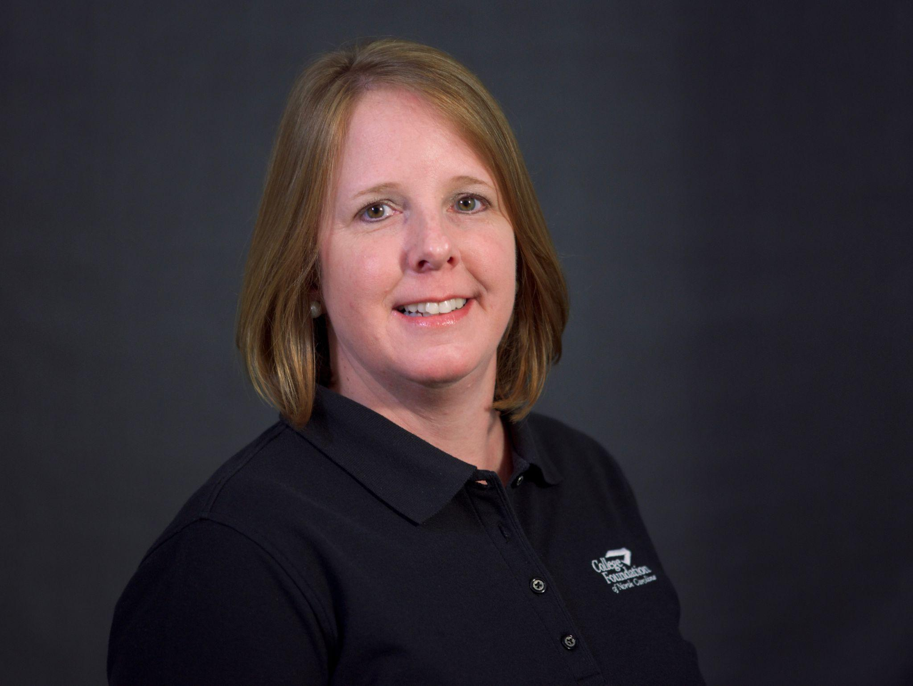
Today’s Presenters
Breé Shepard
CFNC Pathways
cfnc-campus@northcarolina.edu
336-256-3009
Brittany Privott
CFNC Regional Representative
Brittany.Privott@cfi.org
910-280-1883
Sarita Broadway
CFNC Regional Representative
Sarita.Broadway@cfi.org
919-264-3686
Amy Denton
CFNC Regional Representative
Amy.Denton@cfi.org
252-402-6157

Slide 3
Mission of the Admissions Professionals Committee
This committee strives to enhance the relationship between our college partners and CFNC.
We’re new! Why?
Because we recognized that we had not included you in the past
Because you are the goal for many of the students we serve
Because you have different needs in terms of training, advice, and outreach

Slide 4

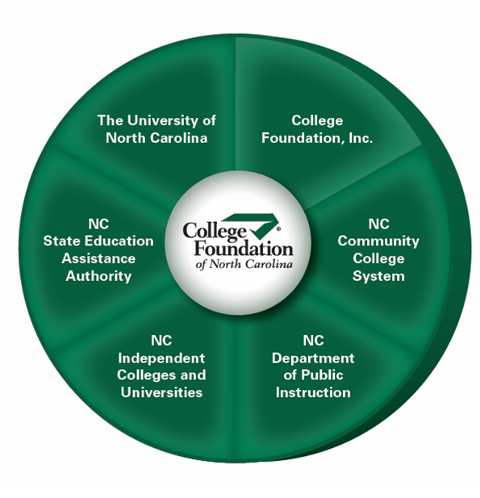
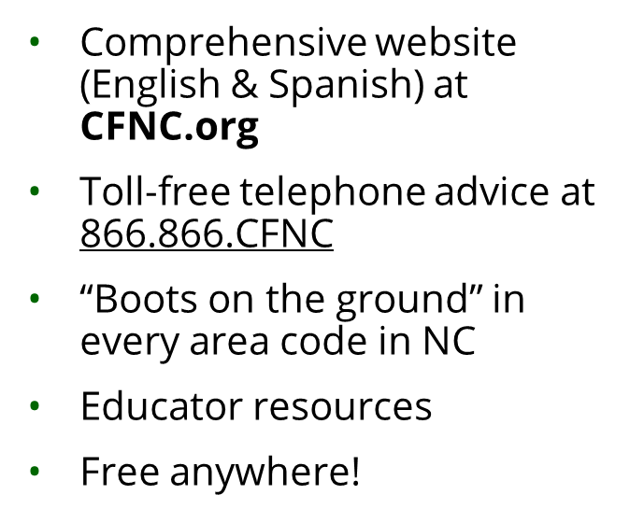

Who is CFNC?

Slide 5
C2C Mission
NC Countdown to College is a month-long initiative to increase the number of students who pursue post-secondary education by assisting high school seniors with the college admissions process and ensuring that each participating student submits at least one admissions application.
This initiative includes College Application Week, when many NC colleges and universities waive application fees. October 16-20, 2023
Notes:
Talk about everyone involved
-students
-parents/families
-CFNC Reps
-high schools (app completion activities/events)
-community partners
-Community Colleges - all institutions can use as a recruiting event
-NCICU
-UNC System

Slide 6
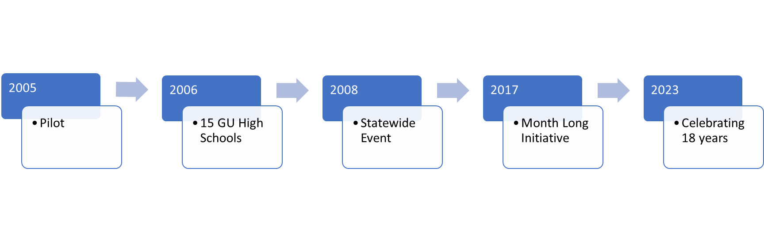
Understanding NC C2C - NC was the First!
NC Countdown to College (C2C) is North Carolina’s annual campaign to help high school seniors complete three important steps in college enrollment:
1. Residency
2. FAFSA
3. Application for admission
October will be focused on these three!

Slide 7
What Will Students Have Done Before CAW?
September is Education Professionals Month - we encourage educators/counselors to help students complete the following items prior to CAW:
Ensure they have a CFNC account
Complete RDS
Complete FSA ID
Complete career assessments on CFNC.org
Review list of colleges waiving application fees during CAW
Pick their top choices of colleges to apply
Students likely reviewed your college profile on CFNC.org!

Slide 8
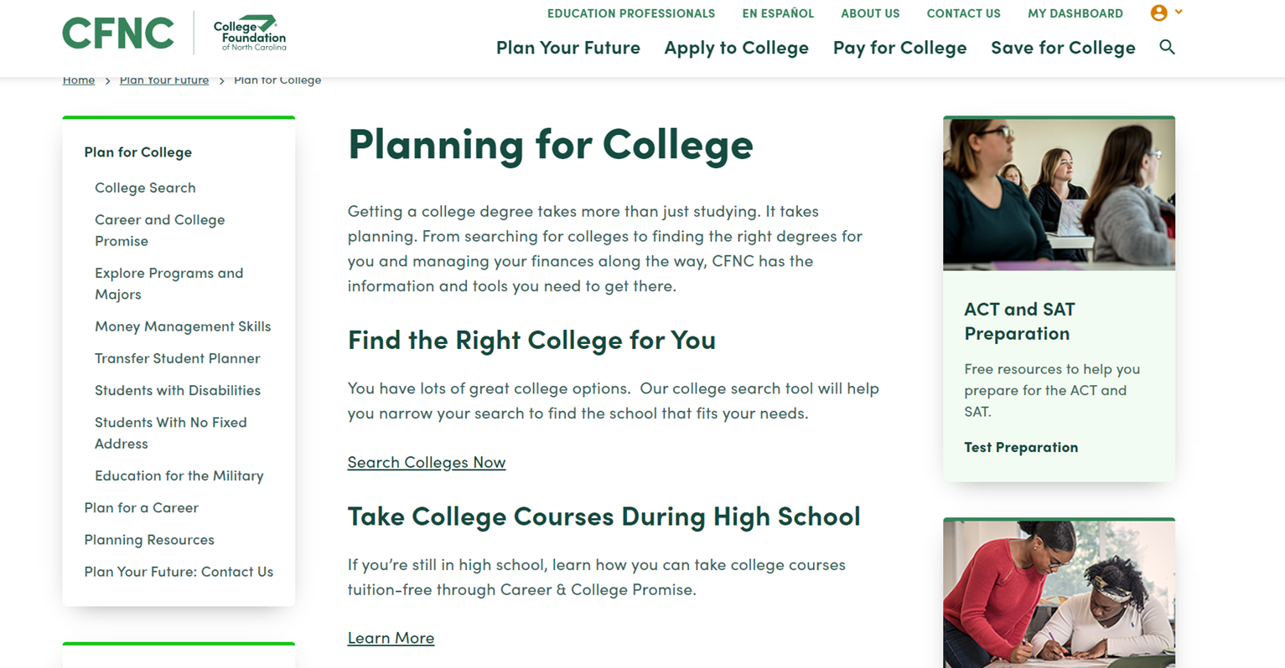
Applicant User Experience - Finding College Information

Slide 9
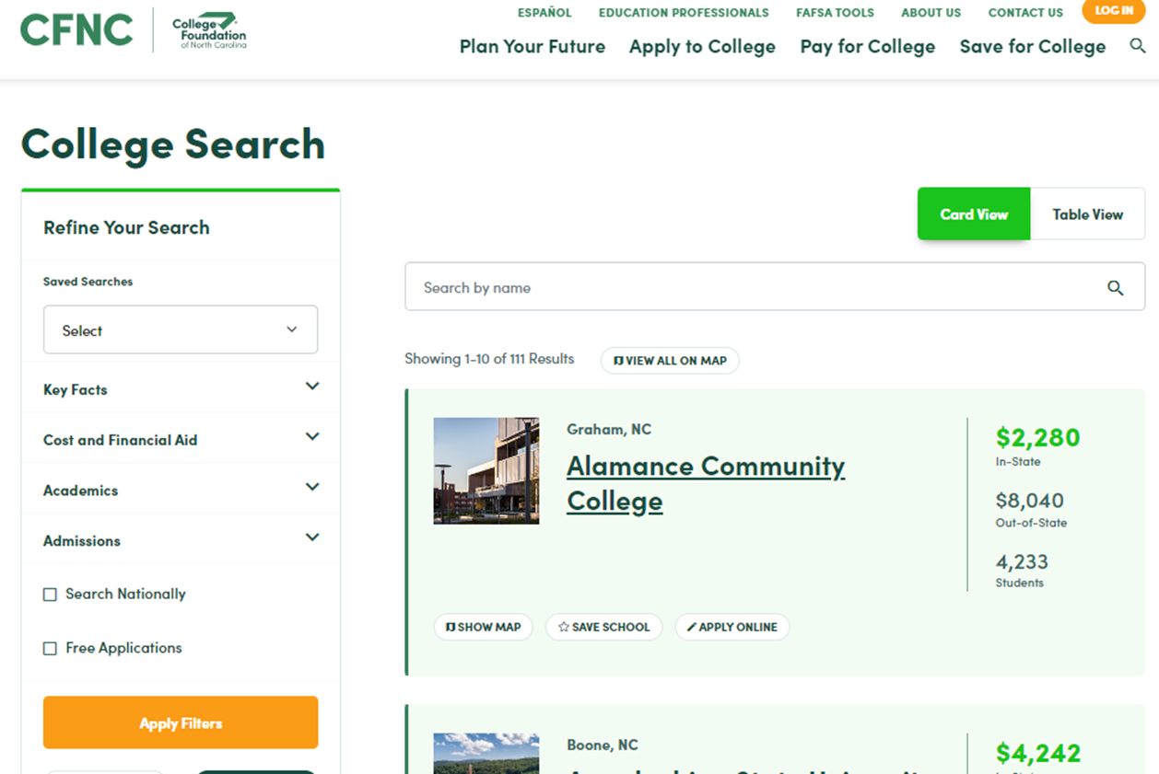
Applicant User Experience - College Search
Find Your College!
During CAW
any institutions waiving fees will be filtered under Free Applications

Slide 10
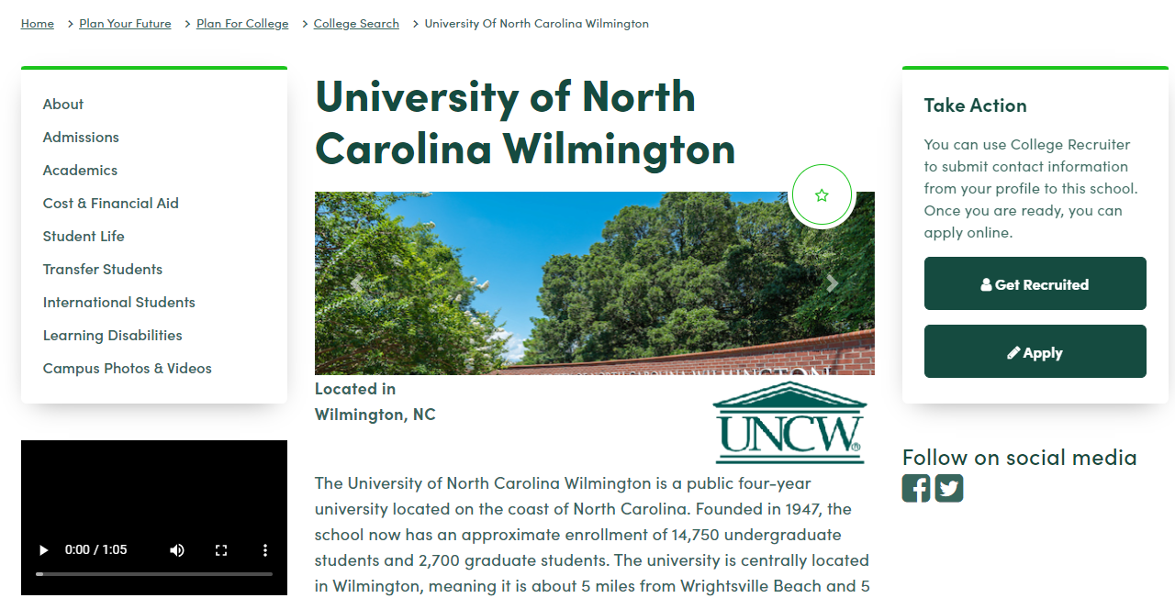
Applicant User Experience - College Profiles
You can update your Profile in CrossConnect.
Some information updated automatically from Peterson’s Databases.

Slide 11
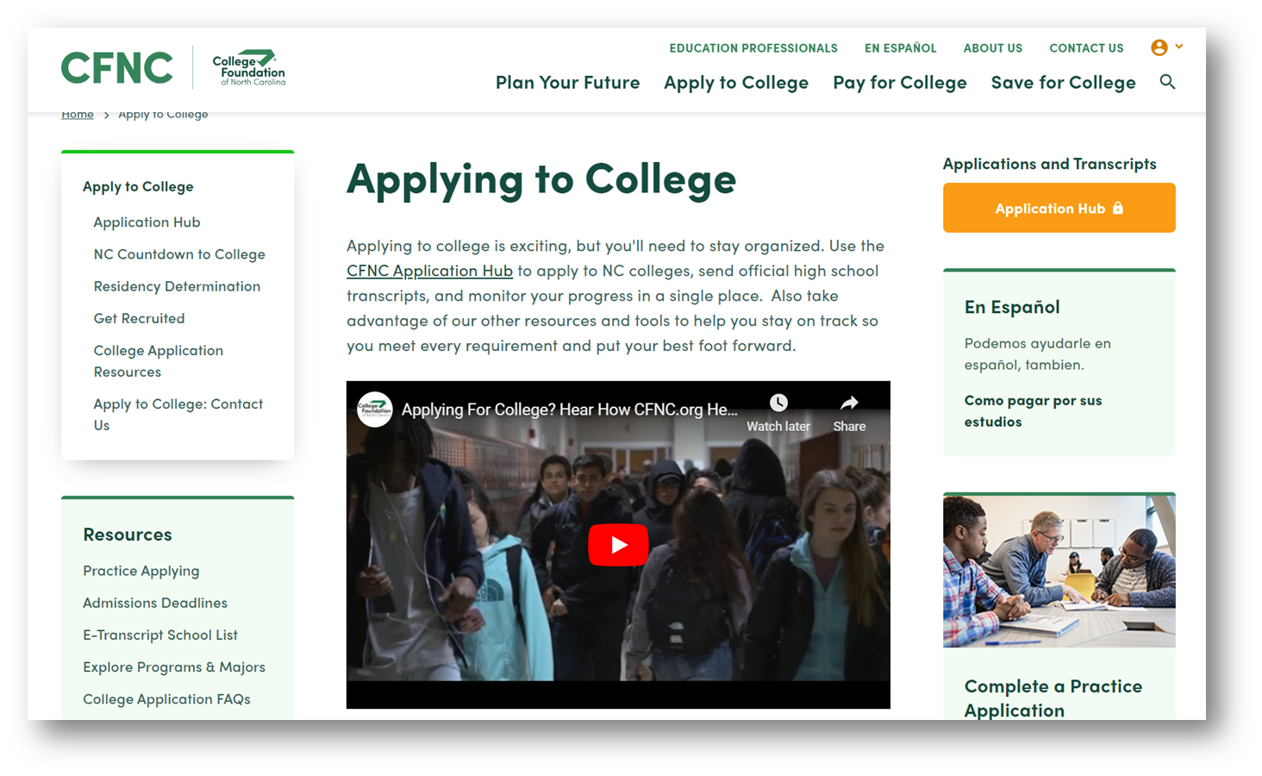
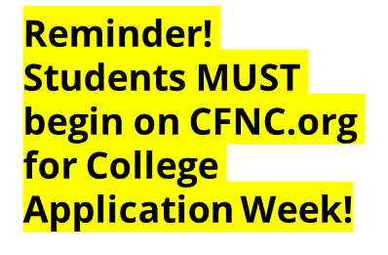
Applicant User Experience - Application Hub

Slide 12
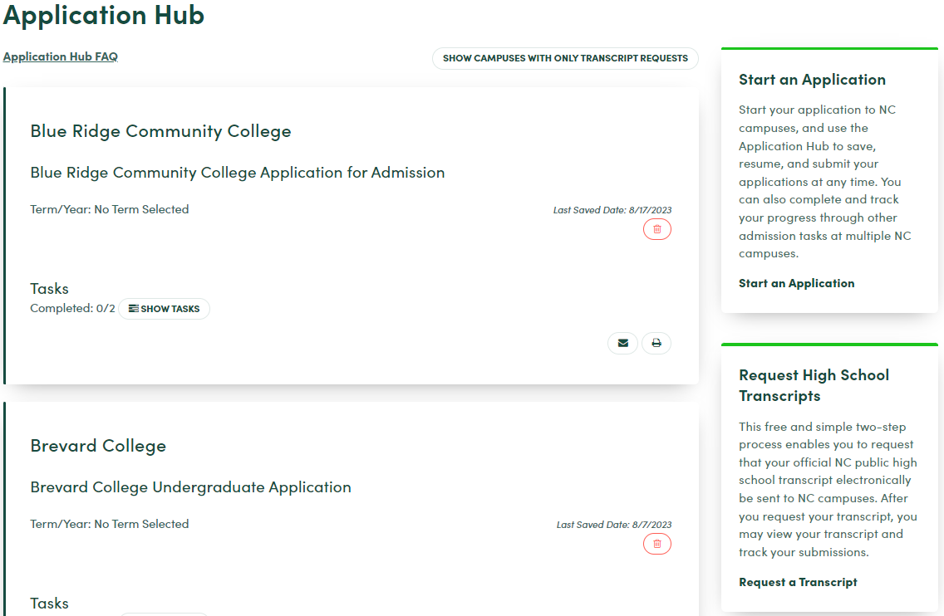
Applicant User Experience - Applications

Slide 13
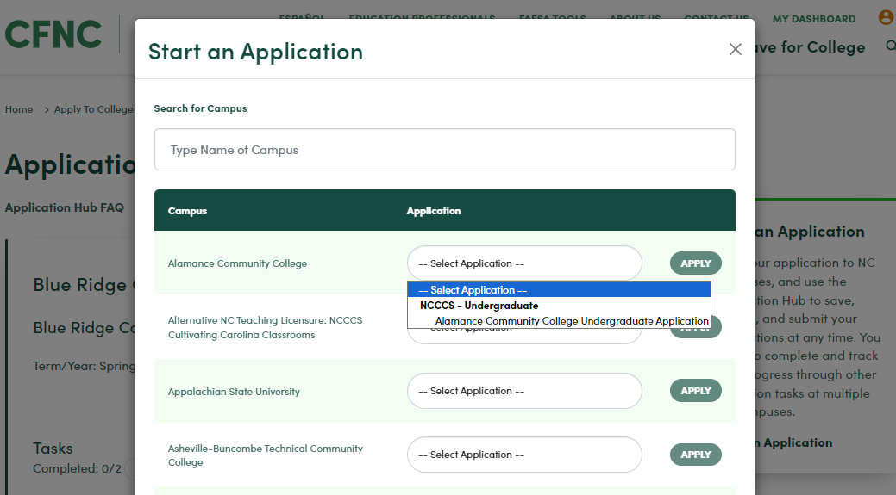
Applicant User Experience - Applications

Slide 14
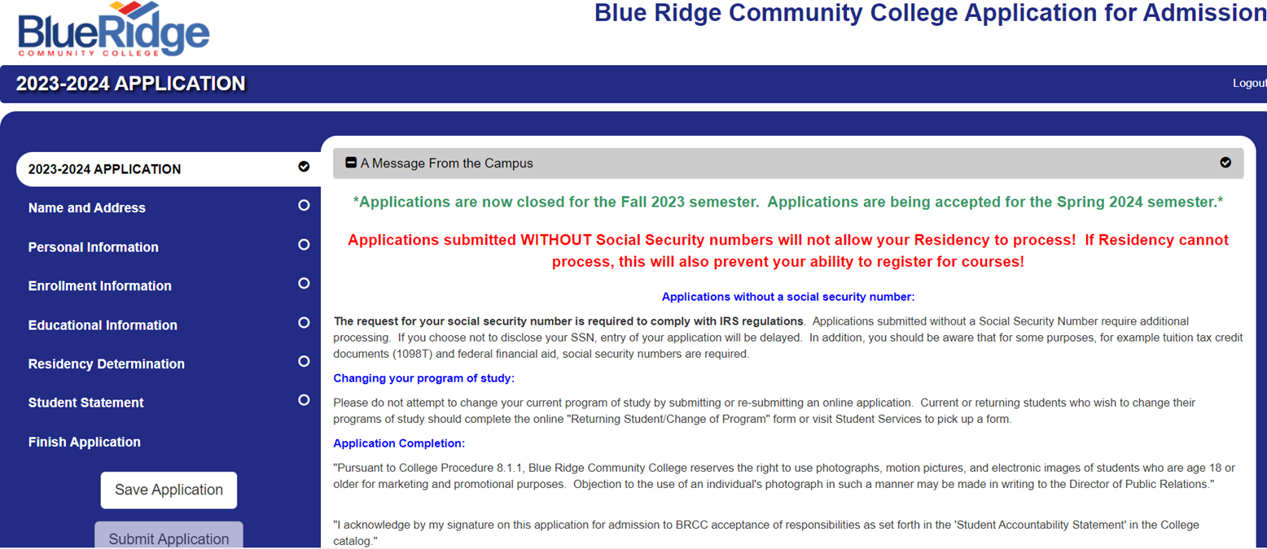


Applicant User Experience - Applications

Slide 15
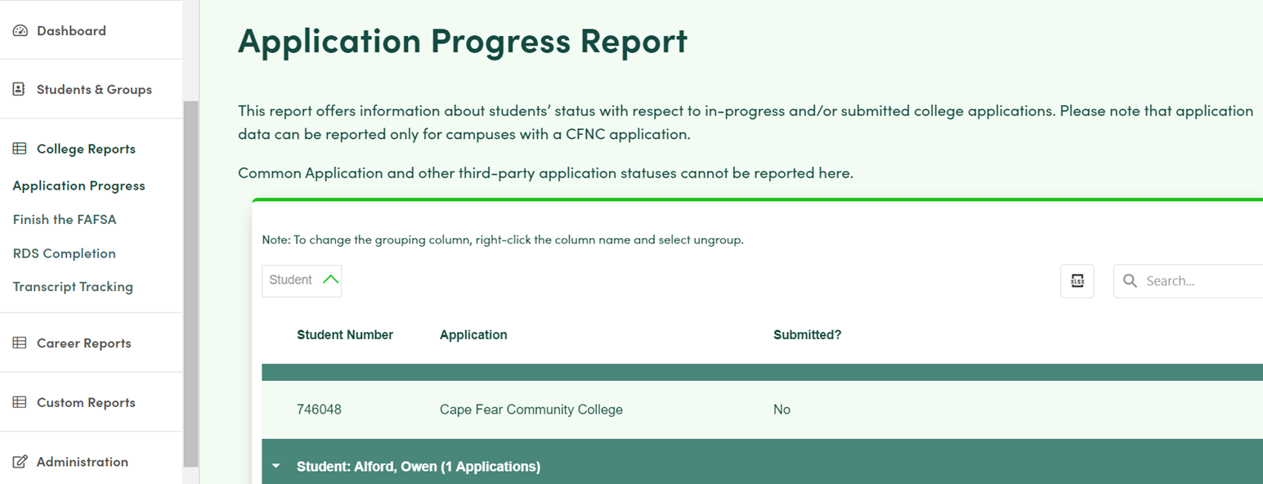


ProTools for High School Educators
Encourage local educators to use this during College Application Week - they can see who has started an application, but not finished.

Slide 16
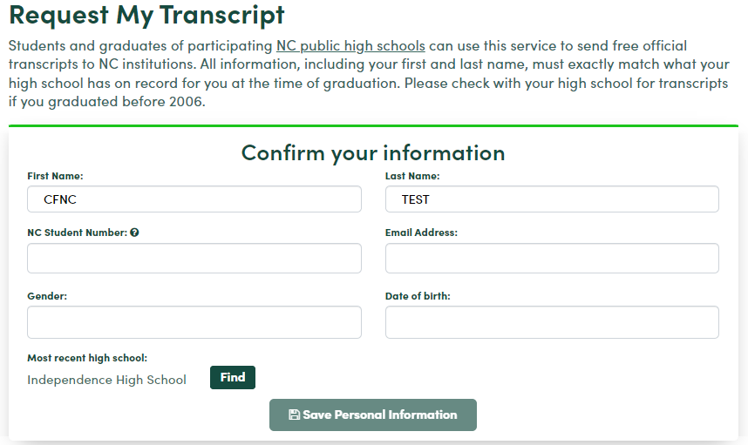
Applicant User Experience - Transcripts

Slide 17
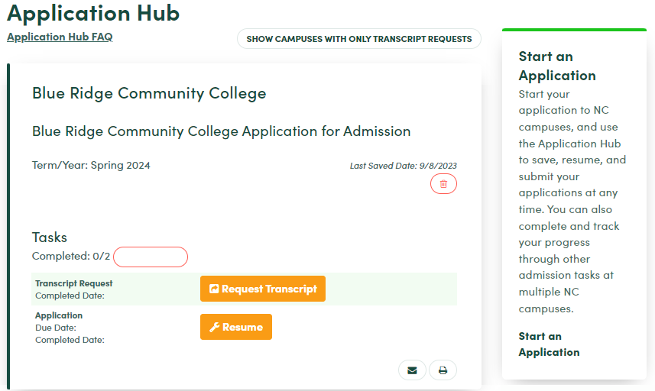
Applicant User Experience - Transcripts

Slide 18
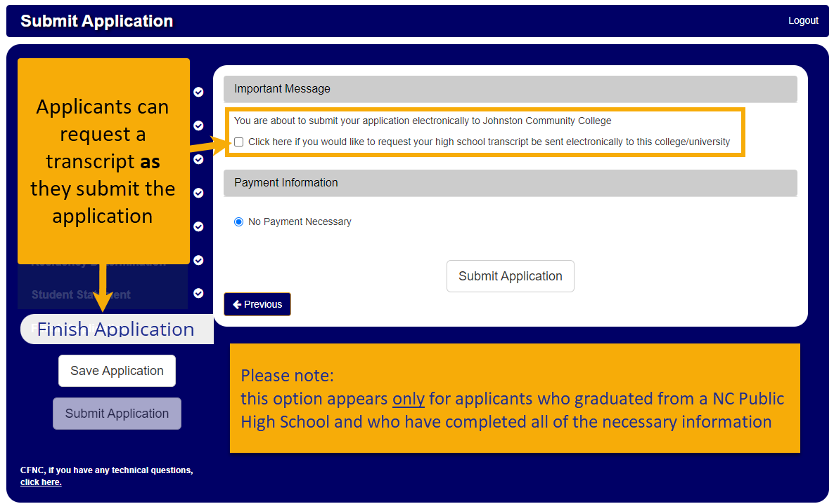
Applicant User Experience - Transcripts

Slide 19
Decisions you need to make now
Who is your CAW Point Person…
for students, families, HS counselors, CFNC Reps
for operations and CrossConnect
What is your policy on…
applicants who cannot submit by the deadline for some reason (ex: computer issues on Friday evening)
Will you…
Pull a list of “in-progress applications” to add to your inquiries in your CRM?
If so, when?
Adjust your communications sent to applicants knowing that their transcripts are likely already requested?

Slide 20
YOUR contact list (for attendees)
For any and all questions or concerns:
Breé Shepard
cfnc-campus@northcarolina.edu
336-256-3009
Breé will be hosting daily drop-in hours from 2pm-4pm during College Application Week:
Teams meeting: https://www.microsoft.com/microsoft-teams/join-a-meeting
Meeting ID: 271 511 718 514 Passcode: 2poGK7
For Social Media Kit or how to get more involved:
Your Local CFNC Representative

Slide 21
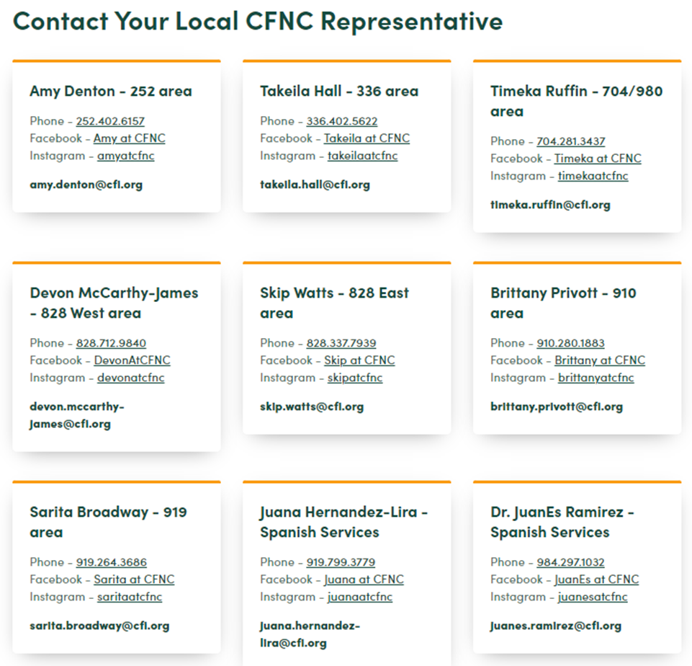

Contacting Your Local CFNC Representative

Slide 22
Countdown to College 2023
Additional Training
201 Advance Session: CrossConnect Users
Tuesday, September 26, 10am-11am
Wednesday, October 4, 2pm-3pm
Resources
NC Countdown to College – main website, direct students and families to this site
cfnc-campus@northcarolina.edu – best way to contact Breé for any assistance you need
Notes:
NC Countdown to College is a month-long initiative to increase the number of students who pursue post-secondary education by assisting high school seniors with the college admissions process and ensuring that each participating student submits at least one admissions application.

Slide 23

Questions? Thank you for Attending!

